Slide 1
Index R(x): Prescriptions for Performance Improvement
SQL Saturday LA 2023
Bill Sanscrainte
Bill@Sanscrainte.com
Notes:
00:00/00:15

Slide 2












Please Visit and Thank Our Sponsors!
Notes:
00:15/00:15

Slide 3



Community Support
Name | Type | Frequency | Join
LA Data Platform | Virtual | Every 3rd Wednesday monthly @ 7PM PDT
Southland Data Professionals | Virtual | Every 3rd Thursday each odd month @ 6.30PM PDT
San Diego SQL Server User Group | Virtual | Every 3rd Thursday monthly @ 6.30PM PDT
Find more Azure Data Tech Groups on Meetup

Slide 4
sp_WhoIsActive?
Bill Sanscrainte linkedin.com/in/billsanscrainte Bill@Sanscrainte.com
41 years with Data
SQL Server since 6.5
1984 - Wrote first SQL query leading first data warehouse project
1994 - Started independent Data Consulting practice
2001 - Started version 1 of what’s presented today
Record holder for most SQL Cruises as a student - SQL Server 10, Oracle 2
Notes:
00:30/00:45

Slide 5
Why are you here?
“Poorly designed indexes and a lack of indexes are primary sources of database application
bottlenecks”
learn.microsoft.com 2023
Notes:
01:15/00:30
And we all know - It’s always the database at fault!
What does DBA stand for? Dumb But Adorable?
Default Blame Acceptor

Slide 6
Legacy Approach for Index Improvement
1000’s of SQL community scripts
Like the truth they are “out there” - some good, some …
“Some assembly required” & “Batteries not included”
Execute each script individually*
Collect results by copy & paste
Find links between related items
Re-format for display and analysis
Sort by database, table, index
Take a guess at what to do
Use hunches to figure out what goes first
*Except sp_Blitz_Index in the First Responder Kit by Brent Ozar
Notes:
01:45/01:00
If you have a monitoring tool your mileage may vary

Slide 7
Special Thanks!
Brent Ozar | Tim Ford | Kimberly Tripp | Jared Westover
Glenn Berry | Kevin Kline | Paul Randall | Monica Rathbun
Pinal Dave | Jason Strate | Aaron Bertrand | Kendall vanDyke
Tom Collins | Kendra Little | Ahmad Yaseen | Niko Neugebauer
Erik Darling | Phil Factor | Edward Pollack | Ola Hallengren
Notes:
02:45/00:15
Shout out to these and others whose community contributions went into this presentation

Slide 8
Let’s Try a Different Way …
Source data from 83 DMVs, System Views, and System Functions …
Connect results across Index, Table, Database, and Total …
Aggregate metrics by Index > Table > Database > Total …
Diagnose by Index, Table, Database, Instance …
Prescribe action(s) for every Index …
Prioritize prescriptions by Table …
Present and analyze in Excel
Notes:
02:45/01:00
<*> Metadata and Properties
- Server, Database, Table, Indexes, Missing Indexes, Foreign Keys, Indexed Views, SQL Table Valued Functions
- Performance metrics, DBCC Showstatistics
- 930+ columns
<*>Prioritize - table level – reading and updating where the data is
<*>Excel 2013+

Slide 9
Notes:
04:00/00:30 NO CLICK
Tada! End product - an Excel workbook taking advantage of Excel’s many presentation and analytic features
No need to squint - we’ll explore each piece in more detail
Using WideWorldImporters sample database
- Total of 400 rows
1 Instance, 1 Database
33 Data tables with 153 heaps and indexes, 3 missing indexes
17 Archive tables with 17 indexes and 1 missing index
99 foreign keys (31 uncovered), 2 Table Valued functions with 1 heap and 1 index
49 “Internal tables” with indexes
Data from the 83 sources compiles to 908 data points
- would not fit on one screen!
- So how do we present it?
<NEXT SLIDE CONTINUES>

Slide 10

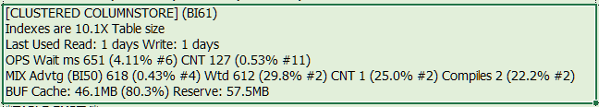
Notes:
Goals:
<*> Reduce scrolling, Compress actionable data as possible into a single 1080p screen
<*> Go vertical in cells - multiple lines for descriptors
<*> Further squeeze cell display - cells expand wide & tall as you click on them
> Shrink back when you click on another cell
<*> Rotate labels to squeeze columns, unlike SSMS
<*> click on column label sorts that column
<*> Color shading to show the good, the bad, and the ugly - notice that no table is all “ugly” or all “good”
<*> Data Filters turned on
<*> Drill down from tables to indexes using “Table Priority” column “B”
<*> Buttons and drop down to control display
<NEXT SLIDE CONTINUES>

Slide 11

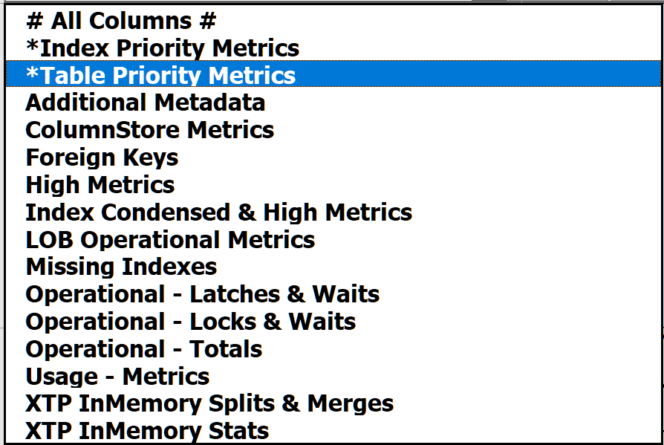
Notes:
05:15/00:45 DON’T CLICK YET
Based on WideWorldImporters
- running Data Load Simulation proc and some custom scripts
- All data returned directly from SQL - no copy paste
sorted in Table action priority order descending - more on that later
Metrics are exaggerated
<*> To save you from being overwhelmed only selected columns are shown
- Drop down chooses topic from “235” columns in the sheet - column group by topic area
- Selection by the drop down in top left corner
- Starts with “table priority metrics” - starting point for your prioritized prescripted index performance improvement journey

Slide 12
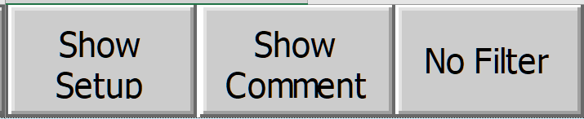

Notes:
06:00/00:45
Dropdowns and buttons to speed insights
Show/Hide Setup Toggle - control display for choosing columns to show and hide, plus display properties
- Edit existing column & create new groups based on research to perform
- If we have time -or- for another session
Show/Hide Comment Toggle - show/hide Excel’s Cell Comment feature
- Uses Excel’s comment feature to provide column-level narrative
No/Remove filter - show all rows after drilldown or filtering results using Excel’s data filters

Slide 13
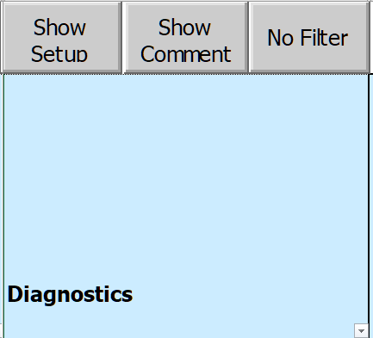
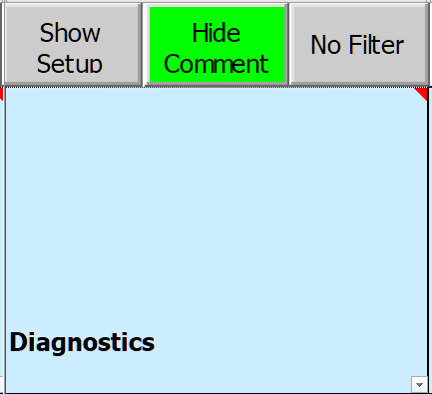
Notes:
06:45/00:45
Click the “Show/Hide Comment” button to enable cell comments
Triangle in top right corner of column label shows comment available
for information about each column heading
Excel likes to resize & relocate comments, so to be consistent click on column label
With a click on column label, sized & positioned to show all comments same place on screen

Slide 14
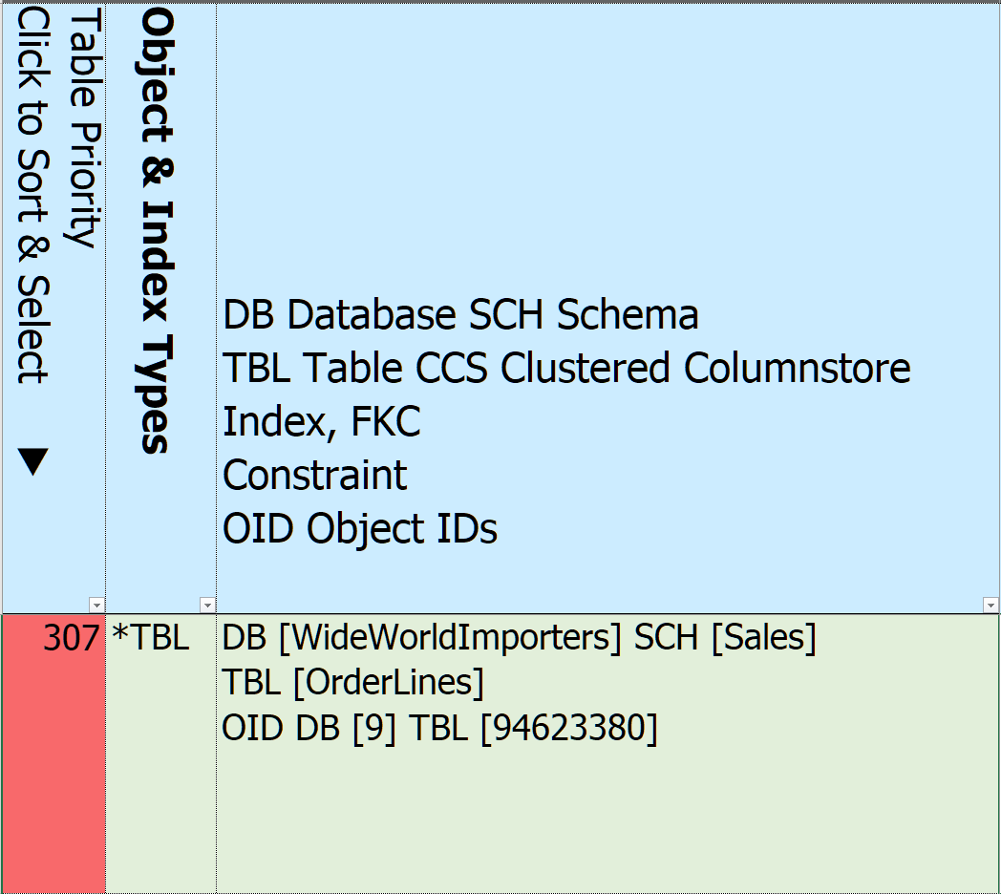
Notes:
07:30/01:00
<*>Table Priority - computed based on overall SQL Index Performance metrics - more on that later
<*>Click column heading to sort
- Triangle display direction, click again to sort in opposite order
<*>Click in row to drill down to indexes
<*>Object & Index Types - abbreviations for principal types, allows for quick grouping by related type
- e.g all clustered indexes, all in memory tables
<*>Database, Schema, and Table name, along with their IDs
Records for Instance and each Database also created

Slide 15
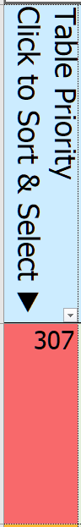
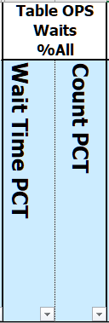
Notes:
08:30/01:00
How did we get to the topmost priority table value 307?
<*> 24 metrics that contribute to table-level performance priority
Start by showing all of the metrics that go into the priority computation - highlighted column labels
<*> For example, let’s explore Table-level aggregate Wait Times and Wait Counts
- All index operation wait times since last reset, divided by the total sample index wait times
- click column label & sort descending
Remember our table [OrderLines]

Slide 16
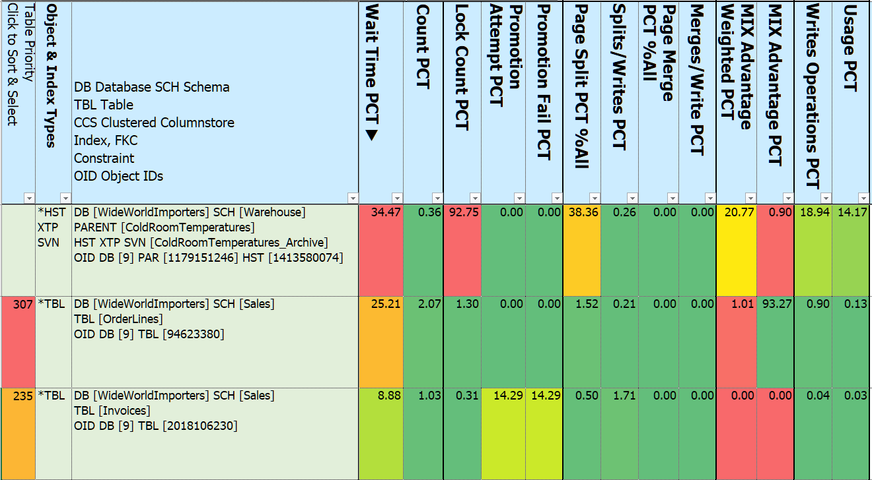
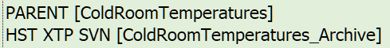
Notes:
09:30/01:00
<*> clicked the column heading Wait Time from the Index Operations metrics to sort DESCENDING
<*> triangle points the sort direction
<*> We’ve zoomed in on the first table-level 13 metrics columns
<*> Over 1/3 of all sample waits are linked to this table
<*> This history table is also noteworthy for High Lock Counts
<*> and Page Splits
<*> The most waited table is a History InMemory System Versioned Temporal Table
- It’s Parent table is [ColdRoomTemperatures] - more on that in a moment
<*> No priority assigned to this table - it’s System created and there’s little we can do about it - except drop it?
Same parent-child behavior exists with other type of SQL Server history tables
- Change Data Capture (CDC) and Ledger tables (new in 2022)
Click again on the Table Wait Time percent & sorts …

Slide 17
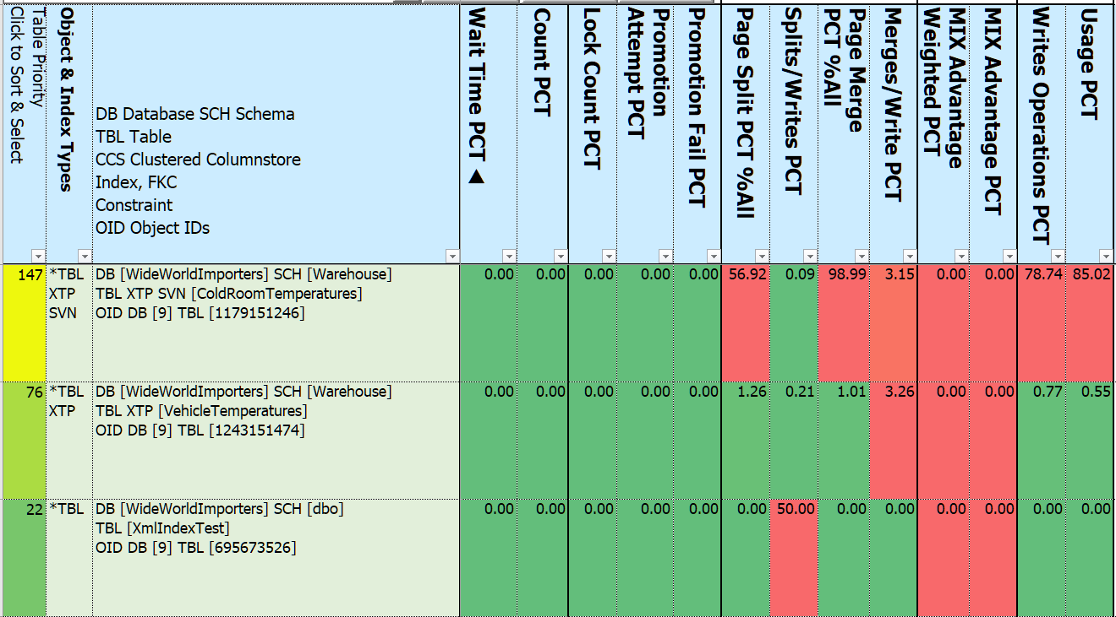
Notes:
010:30/01:00
Ascending - note that there can be great variability across priority metrics
InMemory System Temporal Versioned table [ColdRoomTemperatures]
Table only has 4 rows, but is updated every 75 seconds or so
everything gets re-written to Archive table
the other side of what we just saw with the DESCENDING sort
splits & merges high as percent of total
Not so high as percent of all write activity

Slide 18
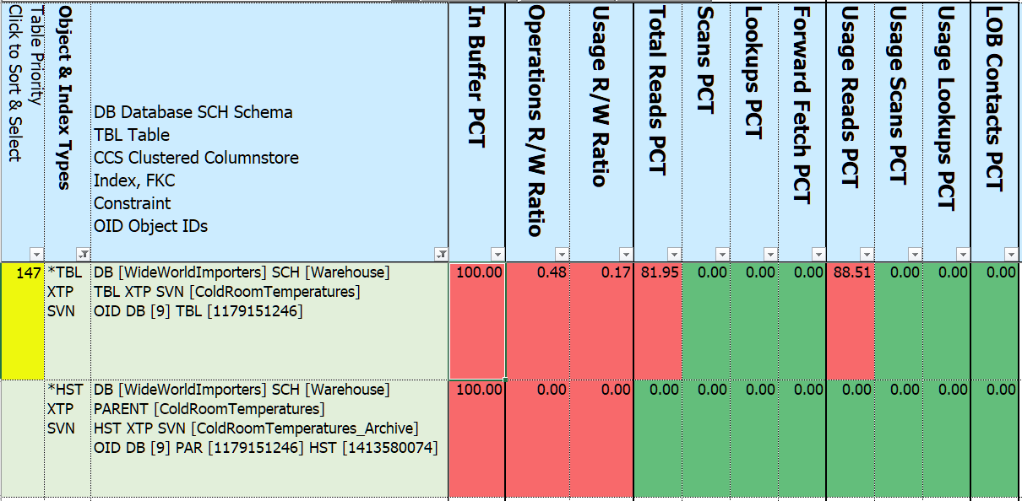
And even more “Children” - System Internal Tables
Notes:
11:30/1:00 demo database
Let’s put the parent and child ColdroomTemperatures together to get a glimpse of the bigger picture
Using data filters look for [ColdroomTemperatures]
<*> And show the remaining 11 priority metrics columns
<*> In Buffer 100% - since both InMemory objects all in memory
<*> XTP – In Memory OLTP
<*> Parent reading after writing is 82% of all reads
<*> Once archived, no reads
<*>Index details can be found by clicking column “B” - table priority
<*>(button press)
<*>And - even more Parent-Child
Internal Tables
Auto generated to support History Tables, XML, FullText, Spatial, Hash Indexes
Typically don’t contain user-accessible data
Fixed schema - alterations not allowed
e.g. XML_INDEX_NODES CHANGE_TRACKING
Metrics separate from the Parent table

Slide 19
Prioritizing – (Parent) Table Share of Metric
Index Waits - time & count ++++++
Missing Index Advantage +++++
Memory Buffer Percent of Index (exclude InMemory) +++++
Locks - Count, Promotion Attempts, Promotion Fails ++++
Page Splits, Merges ++++
Heap Forwarded Fetch ++++
Writes - Operations, Usage +++
Reads - Scans & Lookups % of all reads ++
LOB - Fetch, Overflow Fetch, Value pull in/push off row ++
Read to Write Ratio - Operations, Usage +
Notes:
20:00 How do we know where to start?
Tune access at the table level – where data lives
What statistics does SQL Server keep that track retrieving and maintain data?
27 metrics combined into 18 categories:
<*> Writes - Usage - per query, Operations - per use
The “Total” is either a single database chosen at run time, or all USER databases
Getting back to the spreadsheet …

Slide 20
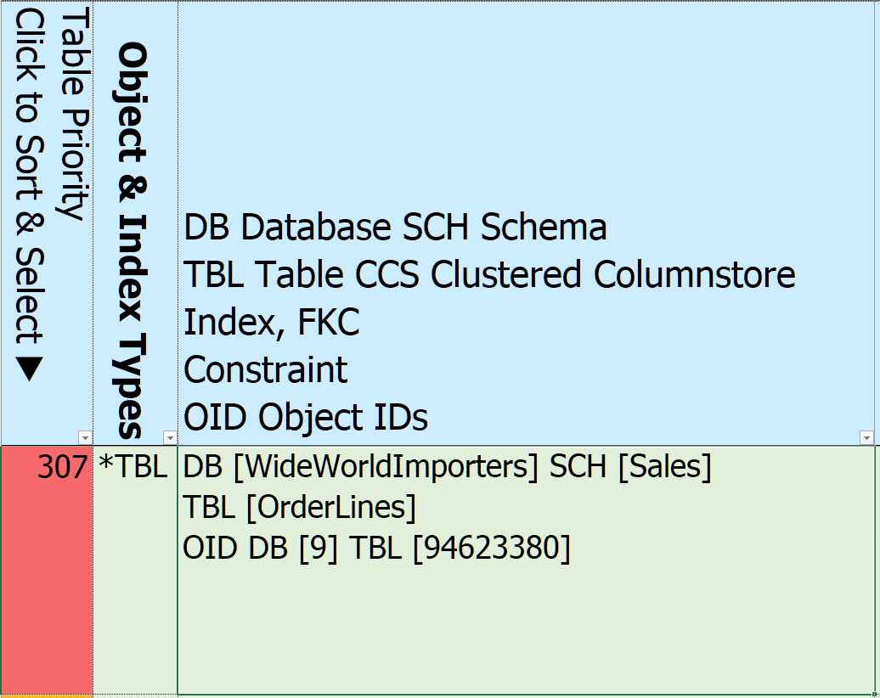
Notes:
15:30/00:30
Highest rated table is [Sales]. [OrderLines]
Click on the “307” to drill down to the index level

Slide 21
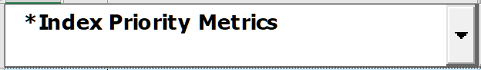
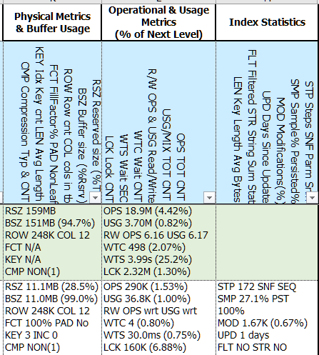
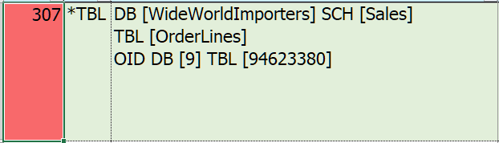
Notes:
20:00/01:00
<*> Index Priority Metrics - drilled into index level
<*> show table information
<*> First 11 of the 22 “Index” objects for table Orderlines in the Sales schema - sorted
Clustered index, Nonclustered Columnstore, 13 nonclustered indexes
4 covered foreign keys, 1 uncovered foreign key, 1 missing index
Also includes child tables and their indexes
- History (CDC, System Versioned, Ledger)
- Internal (supporting the “special” index types XML, SPATIAL, FULLTEXT, HASH)
<*>Looks like a lot, but …
Mostly same columns as Table Priority Metrics
But Metrics are now at the index level as a percent of the table totals
<*> 6 Packs
<*> Key & Included Columns
<*> Prescriptions

Slide 22
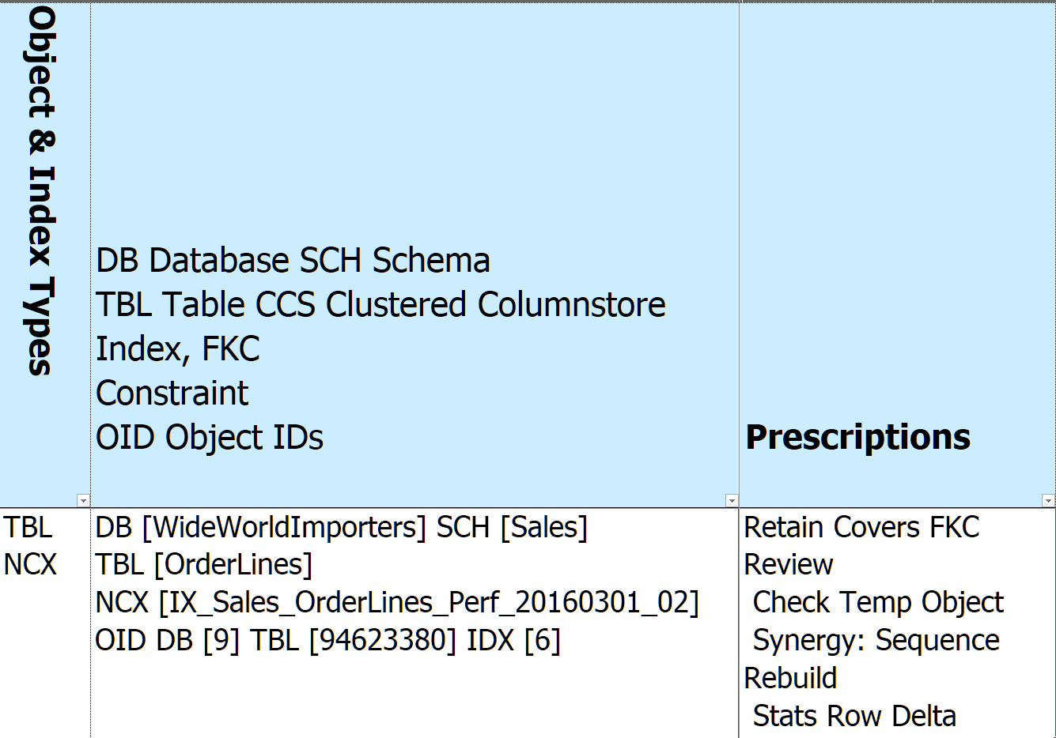
Notes:
27:00
Grabbed a representative row for a Nonclustered Rowstore index –
IX_Sales_OrderLines_Perf_20160301_02
<*>NCX
Index name & ID added to the names column
Prescriptions -
Retain - covered FKC. Runtime parameter
Review - name looks like it could be temporary (YYYYMMDD format)
Review - Synergy - Sequence - means that one or more index keys match in order
Rebuild - Stats Row Delta - row difference between last statistics update and physical table
Let’s Dive into Prescriptions

Slide 23
Index R(x) Prescriptions
Retain Constraints, Clustered, Foreign Key covers*, “gooder”, no writes
Replace With updatable Nonclustered Columnstore* (SQL 2016+ Enterprise)
Request Clustered indexes on Heaps, Missing Indexes adding value
Reject Missing Indexes that … don’t add value -or- table has/will have NCS
Remove Redundant, cost more than they benefit - Reads < 4 x writes
Review “It Depends” for indexes tagged above
Rebuild Retained indexes that need refreshed Statistics or Reorg/Rebuild
Refactor Retained indexes benefiting from structural changes
*Based on parameter selected at run time
Notes:
30:00 DON’T CLICK
Analyze 196 metrics, 500+ diagnostics, key column synergies
Create 97 prescriptions
Group into 8 categories
<*> Retain - the easy one - do nothing - foreign keys, history tables, specialty indexes, contraints,
- “better” if overlaps/synergies
<*>*Based on parameter selected at run time
Replace - and flag extra columns that may be needed
Remove - if index not used but not written to - no harm no foul
- Write = (Spinlocks, Latches, Locks) + Buffer Cache + Log + Disk
Rebuild - FRAGMENTATION
Refactor - e.g. Index partitions don’t match table partitions

Slide 24
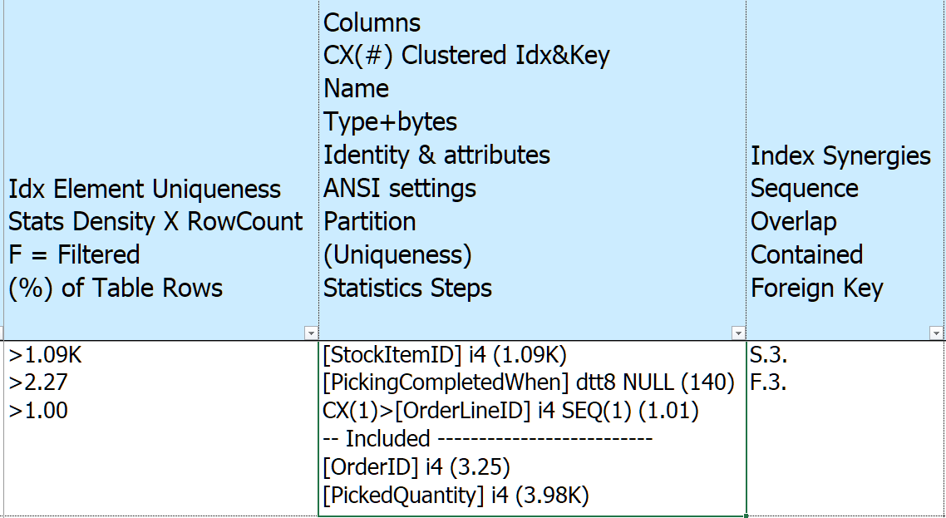
Notes:
33:30
Back to our selected index - IX_Sales_OrderLines_Perf_20160301_02
Lot to unpack - start with center column
Info of index key columns & included columns
<*> Name
<*> Data Type - i4 = Integer 4 bytes, dtt8 = 8 byte datetime2
<*> in parenthesis “uniqueness” from statistics = how may rows on average share a column value
<*> dtt8 DATETTIME2 8 bytes
<*> Null = NULLABLE
<*> CX(1)> = every nonclustered rowstore gets the clustered index added to it
<*> SEQ(1) = sequence, increment by 1, plus uniquifier if clustered is not unique
<*> Included
If there were other column properties would be expressed here too - e.g. if is sparse
To the left - Idx Element Uniqueness
For each additional element in index how many rows are expected to be returned on average
2 kinds of statistics - Histogram (200 buckets) and density (avg rows per combination of index keys)
If column filtered would show “F”
If uniqueness > 4% of table show %
To the right - Synergies
S = Sequence
F = Foreign Key

Slide 25
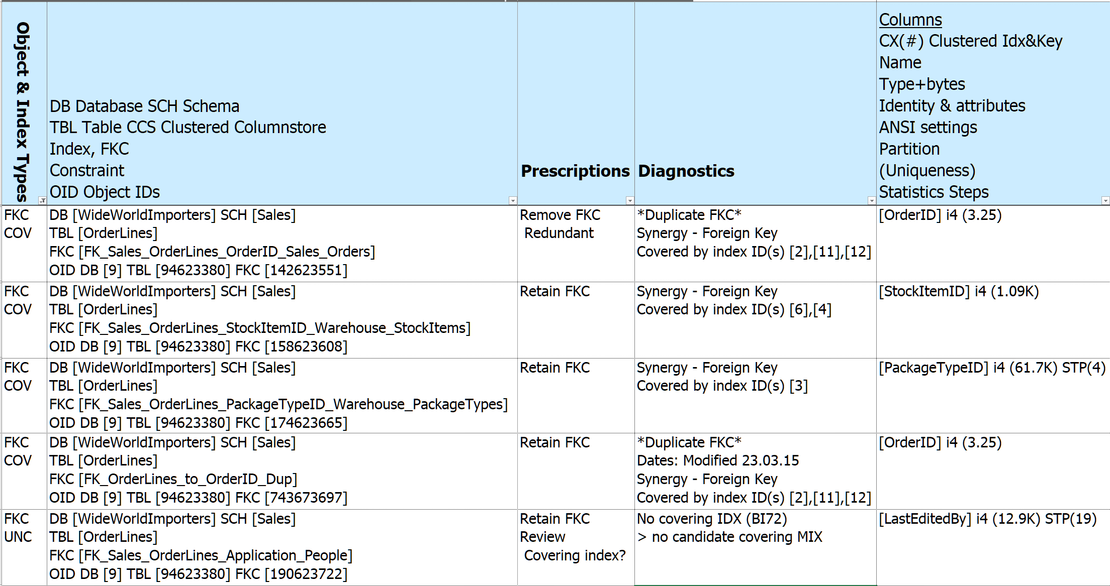
Prescription - Redundant Foreign Key
Notes:
34:30
Prescription DEMO 1 - Foreign Keys - REMOVE Redundant Foreign Keys
SUBSET OF COLUMNS
<*> Covered foreign keys
<*> Uncovered Foreign Keys
<*> Removal flagged in the Prescriptions column
<*> Check out the columns in each FKC - duplicates - also flagged in Synergies column (not shown) or column sort
<*> Diagnostics - draws from Synergies
<*> In the event of a tie keep the FKC that is most:
Enabled, Trusted
More columns in sequence matching order
delete_& update referential_action
Not system named
is_published, is_schema_published, is_replicated
Most recent created
<*>remaining RETAIN
<*>FKC without covering index - and no Missing Indexes calling out the “LastEditedBy” column

Slide 26
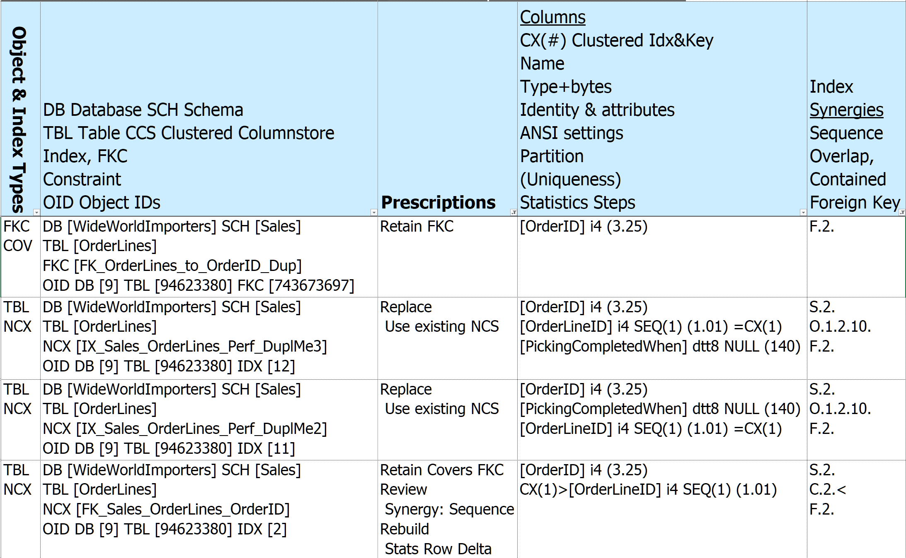
Prescription - Redundant Indexes Covering Foreign Key
2 + Clustered
2 + Clustered
1 + Clustered
Notes:
36:30
Prescription DEMO 2 - Replace Synergy NCX
Retain Foreign Key Cover
Previously noted that this tables has an NCS, so take close look at all NCX
3 candidate NCX indexes to continue covering Foreign Key, all can be replaced by Nonclustered Columnstore
But NCS cannot cover FKC
So pick the smallest index to provide cover - selected index has only 1 column plus the clustering key
If a tie pick the one most used, then recently created
Diagnostics left off

Slide 27
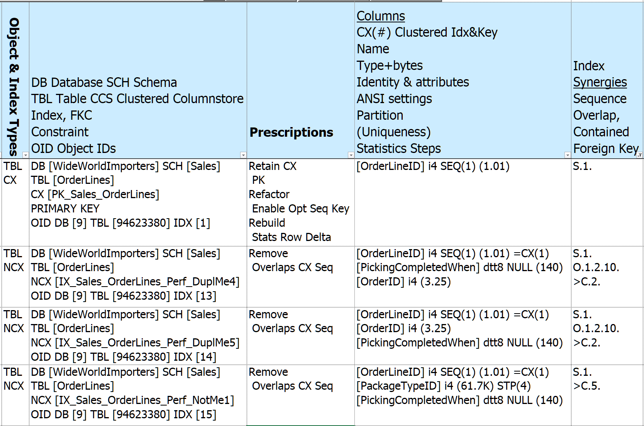
Prescription - Clustered Rowstore Synergies
Notes:
38:30
Prescription Demo 3 - Clustered Index Synergy -or- NCX Overlaps CX
SUBSET OF COLUMNS
Diagnostics left off

Slide 28
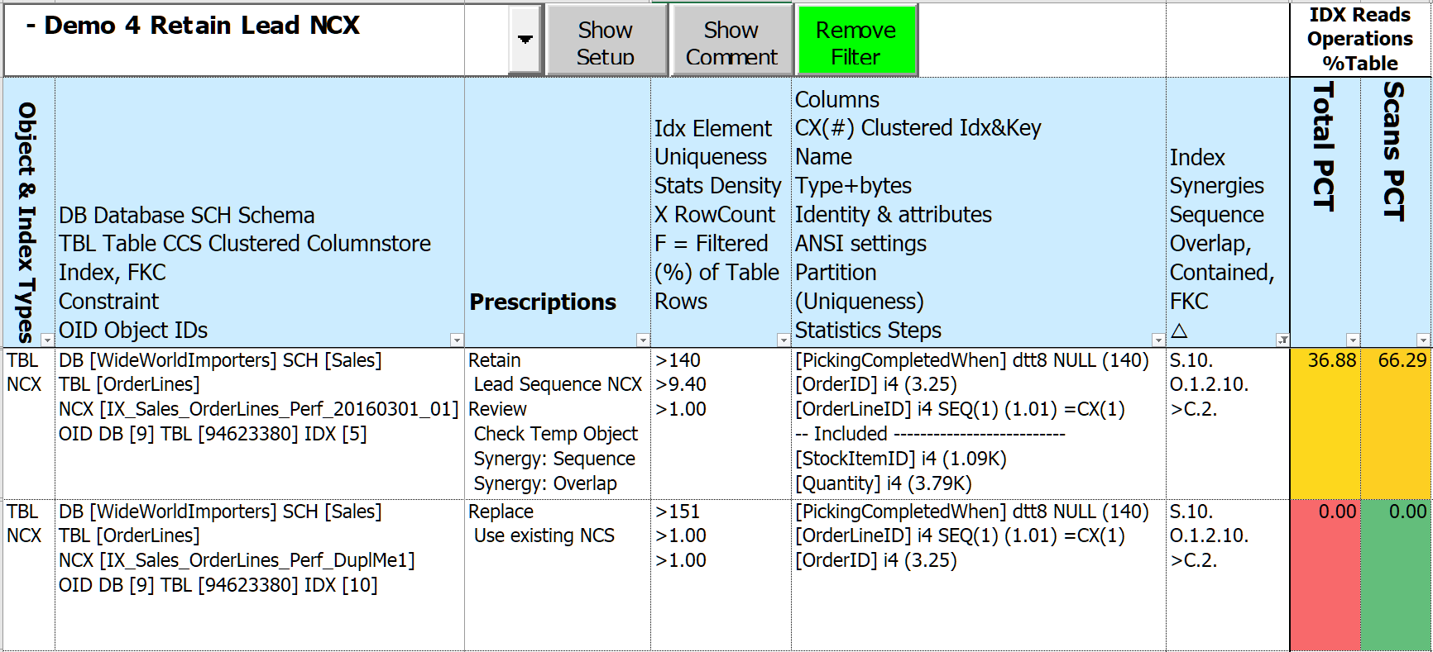
Prescription - Nonclustered Rowstore Synergies
Notes:
40:00
Prescription Demo 4 - Synergy Nonclustered Rowstore
SUBSET OF COLUMNS
Records in table 248K, so lead column uniqueness 140/248K not too many records expected to return
Column [PickingCompletedWhen] likely similar (hopefully growing over time)

Slide 29
Updatable Nonclustered Columnstore - Enterprise Edition and SQL 2016+
Wicked fast
High data compression rates - smaller in-memory footprint
Batch execution - improve performance through Parallelism
Selecting & filtering on multiple index keys at once - reduces I/O
But!
1 per table - covers most data types
Excluded types - geo%, hierarchyid, image, %text, sql_variant, timestamp, xml
Writes create Delta (Residual) Rowgroups and Deleted Bitmaps
Performance hit!
Can’t cover Foreign Key Constraints
Notes:
40:00
query results merged from 3 places!
1 per table - but can have all included column types
Reorg - Creates many small Rowgroups, reducing efficiency
Rebuild - Offline < SQL 2019, merges all Rowgroups, removes Deletes - Expensive!
probably best performed in dedicated maintenance window

Slide 30
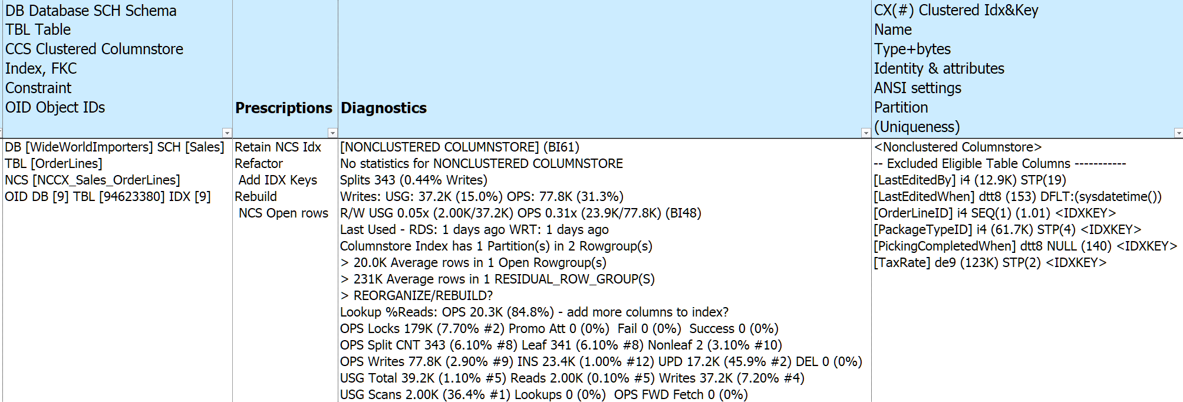
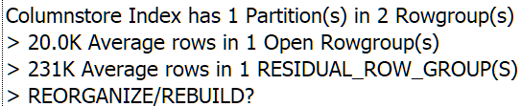
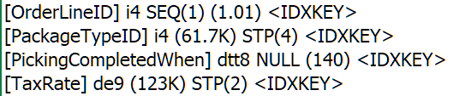
Prescription - Nonclustered Columnstore Insights
Notes:
42:30
Prescription DEMO 5 - Keep NCS - retain since somebody put time into NCS
BI61 - “Columnstore Index”
Refactor – Add IDX Keys
Other columns that can be included
Refactor since there are index key fields not included - see “columns”
Lots of lookups - 85% - hopefully adding more columns will reduce that alot
Quite a bit of write activity, 1 existing open rowgroups and 1 residual (delta) rowgroups
Possibly schedule a rebuild task?
Low read to write ratio - not much SELECT inclusion yet
Otherwise those reads would be done on other indexes

Slide 31
Diagnostics
500+ diagnoses
Instance & Database(s)
Tables (includes Views, SQL Table Valued Functions)
Indexes (includes Foreign Keys, Constraints, Missing Indexes)
Identify items that “stand out”
Non-default properties, settings, parameters
High proportion of Priority Metrics
Unused or empty objects
“Good to know”
“Key” configuration info - Server, Instance, Database, Query Store …
Dates: Last Read / Written / Modified / Created / Statistics Updated …
Version Aware - don’t ding SQL 2012 for new feature in SQL 2022
Notes:
43:00
Previous slide introduced “Diagnostics”
History and Internal Tables given a pass (mostly)
Link to BlitzIndex when same item found (57 items)

Slide 32
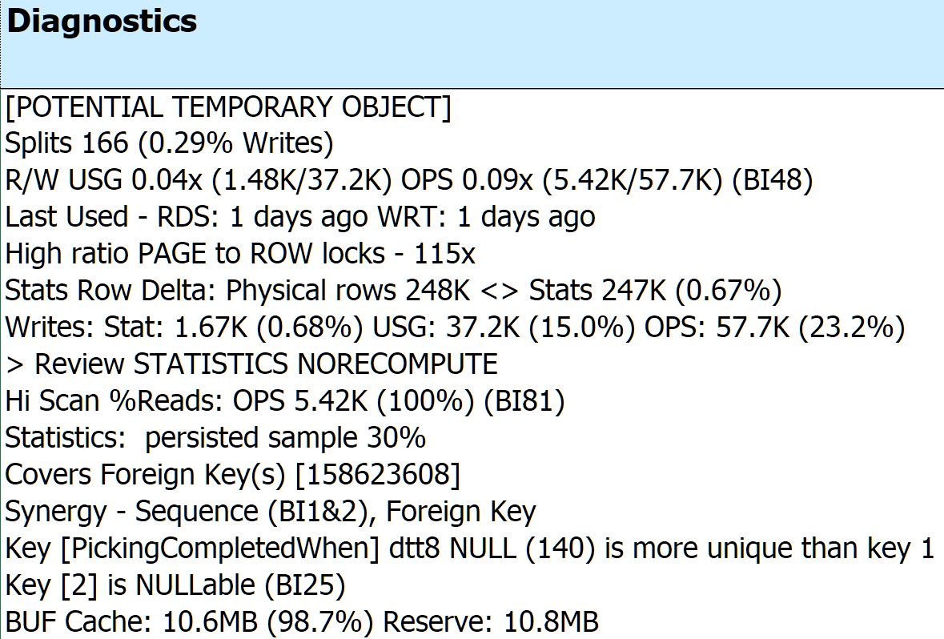
IX_Sales_OrderLines_Perf_20160301_02
Notes:
46:30/03:00
<*>Look at sample “Retained Covers FKC” index
<*>Diagnostics specific to sample index
<*>Click on a cell resizes width & height - click another cell & previous cell shrinks back
- Blowing up the details for Sample index:
- percents computed against table totals
<*>References sp_BlitzIndex Checks by Priority (BI##) from Brent Ozar
<*> [POTENTIAL TEMPORARY OBJECT]
<*> date embedded in the name YYYYMMDD
<*> Splits 166 (0.29% Inserts + Updates + Deletes)
- 3 significant digits
<*> R/W USG 0.04x 25 writes for every read OPS 0.09x 11 writes per read (BI48)
…
<*> KEY [PickingCompletedWhen] has 91 records per value, key 1 [stockitemid] has 1100
<*> KEY [PickingCompletedWhen] is NULLABLE

Slide 33
Execution & Parameters
Parameter Default
Database to include ALL USER DB
Foreign key coverage Keep, add new from Missing Indexes
Use/Create Nonclustered Columnstore YES, if 2016+ & Enterprise
18 Priority Metrics (Varies)
SQL Versions Supported
SQL Server 2012+ (when IIF() function introduced)
Azure (mostly)
Notes:
48:30
Cover if referential_action

Slide 34
Turning prescriptions into improvement
SQL Server Standard Edition means no ONLINE index changes
Much interdependency between indexes and other elements
Clustered index changes work best with no other indexes
Audit & History tables may needs dropping & rebuilding
Foreign Keys and other Constraints may need dropping and rebuilding
There’s never enough Log file space
Scripting DDL changes best left to “experts”
Notes:
49:30
Ignoring Duplicate keys - inserted rows violating uniqueness are ignored
possible data and application issues
Allowing row & page locks
Computed columns - persisted in index
Filtered indexes
Indexed views
Trusting & not Ignoring Duplicate keys may expose hidden issues

Slide 35
Turning prescriptions into improvement (Continued)
A method that’s worked for me:
Clone structure of target database
Apply changes to clone to produce improved “end state”
Create delta scripts using favorite DDL comparison tool: target -> ”end state”
Start creating “rollback code” by comparing in the opposite direction
Apply delta scripts to target database
Re-compare “end state” to target database
Execute rollback code if SHTF
Consider batching changes by table
More time consuming to script
Expedites rollbacks
Notes:
50:00/2:00
Depending on where problem occurs at what stage in the process, rollback code may be incomplete
Many DDL comparison tools batch up all related activities - can be difficult to unwind if failure

Slide 36
Disclaimers!
All change has unintended consequences
It ALWAYS depends!
No express or implied warranty as to fitness for “your situation” - test first!
Don’t boil the ocean
Prioritize
Start small
Rinse & Repeat
Time estimates in lower environments don’t extrapolate to Production
Need to identify & measure “Success”
What’s a baseline?
Know when to say “When”
Notes:
52:30/01:00
With unique “opportunities” for improvement
Baseline - capture meaningful application-level statistics and compare as changes are made
Stop when performance goals are met

Slide 37
Need Your Help!
Looking for “volunteers” to improve SQLXL_Index
Testing against real production workloads
Identify Edge Cases
Bug hunts & error handling
Azure (all flavors)
Tables - Ledger, Graph, Internal types
Indexes - XML, Fulltext, Spatial, Hash
Table Valued Functions
Additional Execution Parameters
Excel workbook labeling, cell comments, and documentation
“Like” to be able to retain a copy of results
See links to source at end
Notes:
53:30
*26K lines of T-SQL and VBA*
Willing to trade consulting time for help in making this a useful tool for the SQL community

Slide 38
There are no stupid
Questions?
Notes:
55:00/4:30
Where worked best - OLTP, SQL2016, 1.5TB, 4 DB; 10K/hr cause infinite slowdown
applied SQLXL_Index, dropped 400 indexes, added 200
tested to 25K, next busy season no issues.
Tested to 75K - still no issues
Busiest Table had 17 columns & 29 indexes. When finished 1 CX, 2 NCX, 1 NCS
Where worked least - DW, SQL 2014, 1TB, 2 DB, multi-tenant, using Cognos dashboard
Average query 8 seconds, average dashboard had 10 objects, could run 4 in parallel - 20 seconds per dashboard
Could not use Updatable NonClustered Columnstore since 2014
Threw CPU, RAM, faster I/O at it
Partitioned tables & indexes, added filtered Indexes & statistics, rebuilt indexes and statistics after every load
Added even more indexes
Rewrote Cognos queries into procedures, average execution time dropped below 3/10ths second
How long to Run
What’s Next

Slide 39
Thanks for coming!
Bill Sanscrainte
linkedin.com/in/billsanscrainte
Bill@Sanscrainte.com
Find presentation, spreadsheet, & T-SQL code at
https://github.com/SQLXL/SQLXL
Link to sp_Blitz_Index Checks
https://github.com/BrentOzarULTD/SQL-Server-First-Responder-Kit/blob/dev/Documentation/sp_BlitzIndex_Checks_by_Priority.md
Notes:
59:30/00:30

